Slide 1
Piece by piece: How to build the evidence base for your psychotherapeutic modality
UKCP Research conference o3-06-2023
Dr Biljana van Rijn, biljana.vanrijn@metanoia.ac.uk
Faculty Head of Research and Doctoral Programmes
SPR UK Chapter, President Elect

Slide 2
My journey
TA psychotherapist and, supervisor and teacher (TSTA). I started my research journey in 2000.
I worked as a manager of clinical services at Metanoia Institute.
I was inspired by the concepts of reflective practice (Schön, D. A. 1983) and double-loop learning.
Understanding our own tacit knowledge as therapists, theories we use in action, and modifying action through observation and experience.
Scientist-practitioner model as redefined by Hoshmand, L. T., & Polkinghorne, D. E. (1992) linking practice-based knowledge, research and training of practitioners.

Slide 3
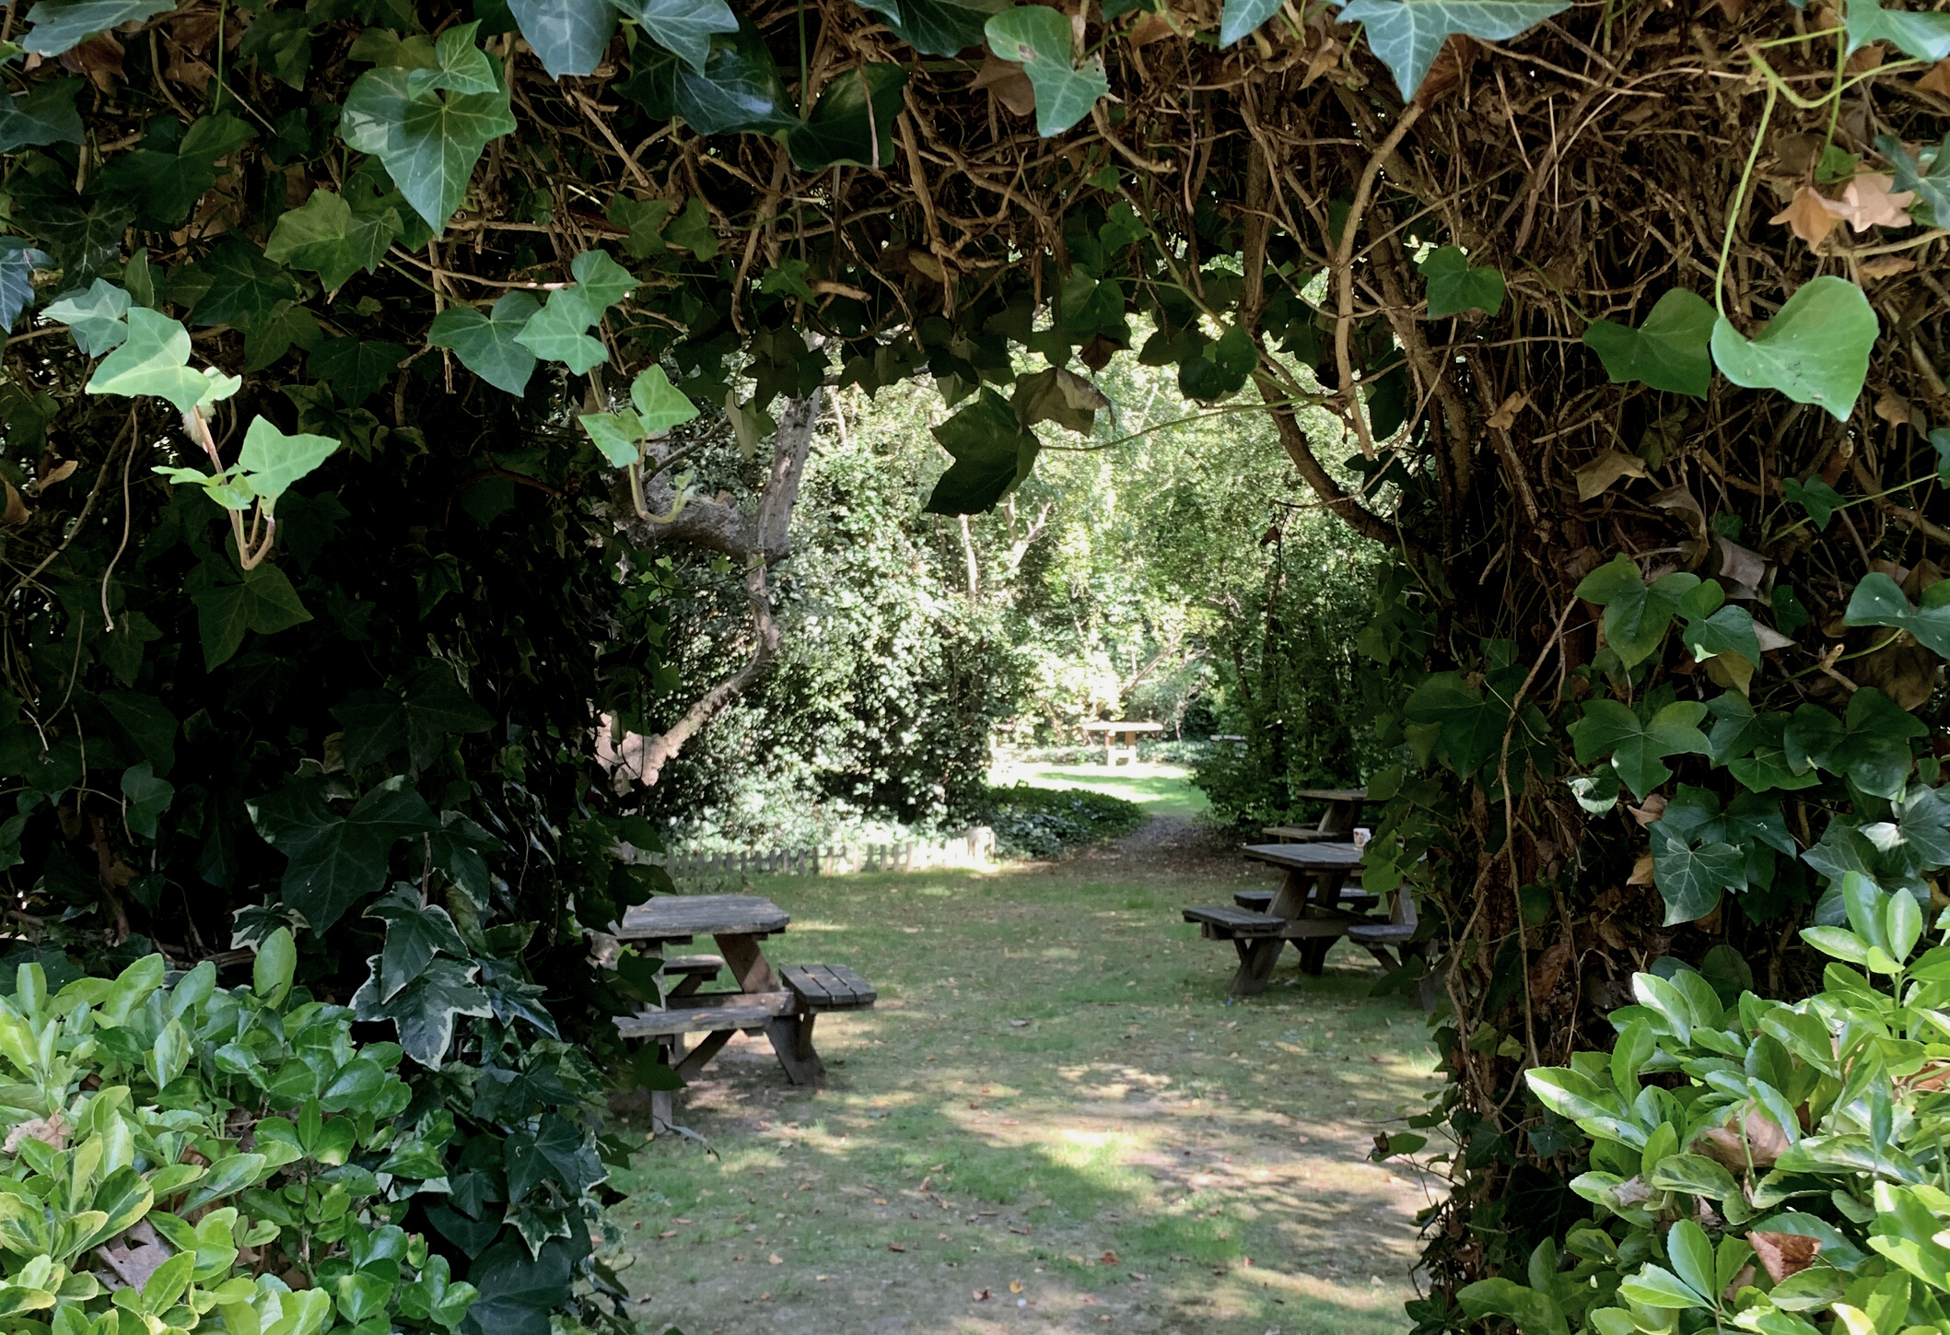
It is argued that the current division between academic researchers and practitioners requires a revised conception of the relationship of science and practice, in which there is productive interplay rather than elevation of one form of knowledge above the other. …
Our hope is that at least more of a balance will be struck as our profession begins to regard practice as the appropriate context for constructing and testing our maps of instrumental knowledge. Furthermore, we propose a greater role for the knowledge of practice in the scientific base of the profession
Hoshmand, L. T., & Polkinghorne, D. E. (1992). Redefining the science-practice relationship and professional training. American Psychologist, 47, 55-66. https://doi.org/10.1037/0003-066X.47.1.55

Slide 4
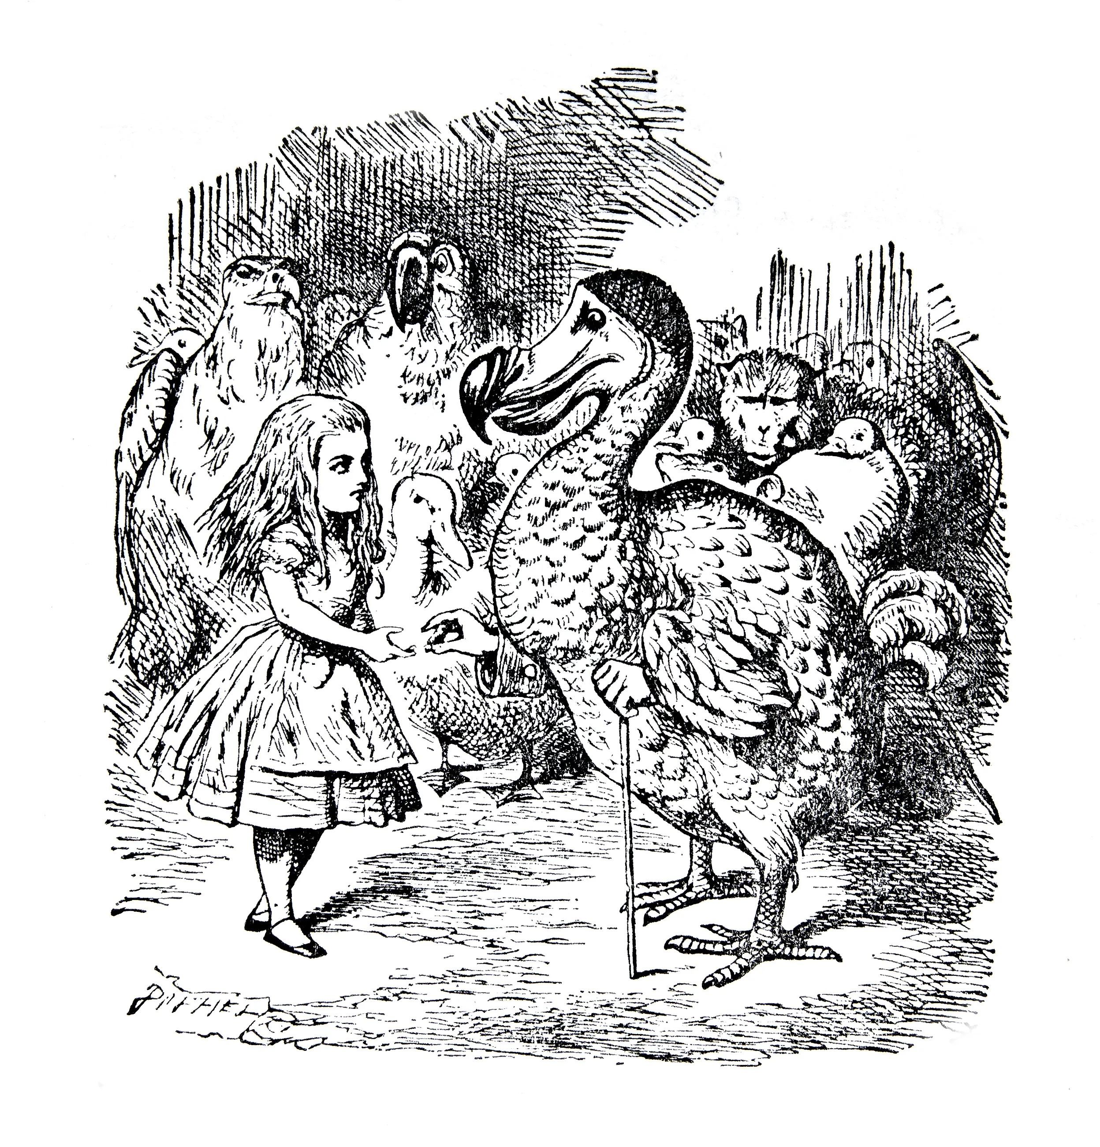
Why bother with outcomes research?
Dodo bird findings?
If everyone has won, does that include my approach?
The power of statutory guidelines
In the UK, as well as in Europe, statutory agencies define guidelines that determine access to therapy.
This is informed by research, as well as cost.
The Improving Access to Psychological Therapies (IAPT) programme started in October 2008.

Slide 5
Practice –based evidence or research-based practice
Evidence-based practice is the integration of best research evidence with clinical expertise and patient values
https://www.england.nhs.uk/tis/wp-content/uploads/sites/17/2014/09/tis-guide-finding-the-evidence-07nov.pdf
Practice –based evidence includes evidence collected in naturalistic settings
IAPT data is PBE.

Slide 6
Developing a research clinic (MCPS)
Stage 1 2000-2008
Pre and Post measures (CORE-OM)
Stage 2 2008-2010
Exploring different measures and frequencies of measurement
Stage 3 2010- current
Routine Outcomes Monitoring
Approximately 500 clients and 130 students per year, collecting naturalistic evidence for humanistic and integrative approaches.

Slide 7
Routine Outcomes Monitoring (ROM)
Routine outcome monitoring (ROM) involves the use of patient-reported standardized outcome measures to monitor progress throughout the treatment.
(Aafjes-van Doorn, K., & de Jong, K. (2022). How to make the most of routine outcome monitoring (ROM): A multitude of clinical decisions and nuances to consider. Journal of clinical psychology, 78(10), 2054-2065. https://doi.org/10.1002/jclp.23438 )
MCPS combines:
Sessional measures (GAD-7;PHQ-9)
Review measures (ARM-5;RDFS;CORE-10)
Vos, J., Chryssafidou, E., van Rijn, B., & Stiles, W. B. (2021). Outcomes of beginning trainee therapists in an outpatient community clinic [https://doi.org/10.1002/capr.12466]. Counselling and Psychotherapy Research, n/a(n/a). https://doi.org/https://doi.org/10.1002/capr.12466

Slide 8
Is RoM sufficient as research evidence base?
No!
Evidencing an approach within a range of other approaches builds an evidence base, but does not answer questions about efficacy and causality.
Questions:
What is an conceptual model and an operational definition of an approach?
What is a state of research in the approach?
Are there any approach specific measures?
Is there an RCT?

Slide 9
Steps in developing an RCT
Develop an evidence based, operational definition of the approach.
Develop a research-based manual
Develop a pilot trial
Develop a full RCT

Slide 10
Developing a conceptual model (Kazdin, 2015; Vos, 2015)
What is the central (psychological, clinical, or experiential) phenomenon in this therapy?
What is the aetiological component or how did this central phenomenon develop?
The therapeutic mechanism component answers the question how can the central phenomenon be changed by providing this therapy?
What are the therapeutic competencies used in your approach?
What are the outcomes?
The synthesis. Summarizes all conceptual components and shows their logical connections and coherence. This then forms your operational definition.
Each component needs to be supported by research and evidence based on the systematic literature review.

Slide 11
TA Conceptual Model (Vos, J., & van Rijn, B. (2021). The Evidence-Based Conceptual Model of Transactional Analysis: A Focused Review of the Research Literature. Transactional Analysis Journal, 1-42. https://doi.org/10.1080/03621537.2021.1904364 )

Slide 12
Developing a Treatment Manual
Treatment Philosophy
Overall model and aims
Key therapeutic skills
Assessment skills
Relational skills
Skills about working at experiential depth in the here-and-now
Treatment structure
Overview of sessions
Stage 1. Establishing relationship, initial assessment, and initial treatment contract (sessions 1-2)
Stage 2. Systematic assessment (sessions 3-6)
Stage 3. EXPERIENTIAL PROCESSING IN THE HERE-AND-NOW (sessions 7-12)
Stage 4. DECIDING & APPLYING SCRIPT CHANGES (sessions 13-16)
Appendices
Questionnaires
Information for clients & informed consent
Who to contact with questions

Slide 13
Developing a trial
Find the research funding
Who is likely to fund research into your theoretical orientation?
Could you start it with seed funding?
( for example, for conducting a systematic review)
What size of funding do you need?
( you may need a research team)
Design the study ( first a pilot trial, then a full trial)
Take time for each step

Slide 14
In summary…
Building a research evidence base for individual therapeutic approaches remains an important task in developing legitimacy and ensuring the longevity of our approaches ( particularly in the humanistic and integrative fields).
It is a step-by-step process, taking time, funding and resources.
One study is not sufficient. We need a body of research including:
ROM in naturalistic settings
Case studies examining outcomes and theories ( such as HSCED and Theory-Building)
Development of approach specific measures measuring defined approach specific outcomes
Meta- analysis of existing research
Development of manuals
… and RCTs

Slide 15
How far have we got to in TA?
Vos,J,van Rijn B. Brief Transactional Analysis Psychotherapy for Depression: The systematic development of a treatment manual, Journal of Psychotherapy Integration, accepted for publication
Vos, J., & van Rijn, B. (2022). The Effectiveness of Transactional Analysis Treatments and Their Predictors: A Systematic Literature Review and Explorative Meta-Analysis. Journal of Humanistic Psychology, 00221678221117111. https://doi.org/10.1177/00221678221117111
Vos, J., & van Rijn, B. (2021). The Evidence-Based Conceptual Model of Transactional Analysis: A Focused Review of the Research Literature. Transactional Analysis Journal, 1-42. https://doi.org/10.1080/03621537.2021.1904364
Vos, J., & van Rijn, B. (2021). The Transactional Analysis Review Survey: An Investigation Into Self-Reported Practices and Philosophies of Psychotherapists. Transactional Analysis Journal, 1-16. https://doi.org/10.1080/03621537.2021.1904355
Vos, J., & van Rijn, B. (2021). A Systematic Review of Psychometric Transactional Analysis Instruments. Transactional Analysis Journal, 1-33. https://doi.org/10.1080/03621537.2021.1904360

Slide 16
Developing an evidence base is like planting a tree of knowledge

Slide 17
biljana.vanrijn@metanoia.ac.uk

